Slide 1
Datapath

Slide 2
Datapath
The datapath is the part of the central processing unit (CPU) that does the actual computations.

Slide 3
Datapath
We can divide the design of our CPU into three parts:
  The datapath does all of the actual data processing.
  An instruction set is the programmer’s interface to CPU.
  A control unit uses the programmer’s instructions to tell the datapath what to do.

Slide 4
Datapath
Today we’ll look in detail at a processor’s datapath, which is responsible for doing all of the dirty work.
  An ALU does computations, as we’ve seen before.
  A limited set of registers serves as fast temporary storage.
  A larger, but slower, random-access memory is also available.

Slide 5
What’s in a CPU?
A processor is just one big sequential circuit.
  Some registers are used to store values, which form the state.
  An ALU performs various operations on the data stored in the registers.

Slide 6
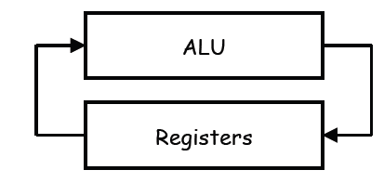
What’s in a CPU?

Slide 7
Register transfers
Fundamentally, the processor is just moving data between registers,
possibly with some ALU computations.
To describe this data movement more precisely, we’ll introduce a register transfer language.
  The objects in the language are registers.
  The basic operations are transfers, where data is copied from one register to another.

Slide 8
Register transfers

Slide 9
Register transfers
We can also use the ALU to perform arithmetic operations on the data while we’re transferring it.

Slide 10
Register transfer language
Arrows indicate data transfers. To copy the contents of the source register R2 into the destination register R1 in one clock cycle:
R1 ← R2
A conditional transfer is performed only if the Boolean condition in front of the colon is true. To transfer R3 to R2 when K = 1:
K: R2 ← R3

Slide 11
Register transfer language
• Multiple transfers on the same clock cycle are separated by commas.
R1 ← R2, K: R2 ← R3
• Don’t confuse this register transfer language with assembly language,
which we’ll discuss next week.

Slide 12
Register transfer operations
We can apply arithmetic operations to registers.
R1 ← R2 + R3
R3 ← R1 - 1
• Logical operations are applied bitwise. AND and OR are denoted with special symbols, to prevent confusion with arithmetic operations.
R2 ← R1 ∧ R2 bitwise AND
R3 ← R0 ∨ R1 bitwise OR

Slide 13
Register transfer operations
Lastly, we can shift registers. Here, the source register R1 is not modified, and we assume that the shift input is just 0.
R2 ← sl R1 left shift
R2 ← sr R1 right shift

Slide 14
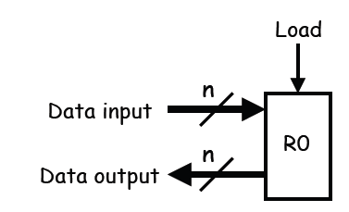
Block symbols for registers

Slide 15
Block symbols for registers
We’ll use this block diagram to represent an n-bit register.
There is a data input and a load input.
  When Load = 1, the data input is stored into the register.
  When Load = 0, the register will keep its current value.

Slide 16
Block symbols for registers
The register’s contents are always available on the output lines, regardless of the Load input.
The clock signal is not shown because it would make the diagram messy.
Remember that the input and output lines are actually n bits wide!

Slide 17
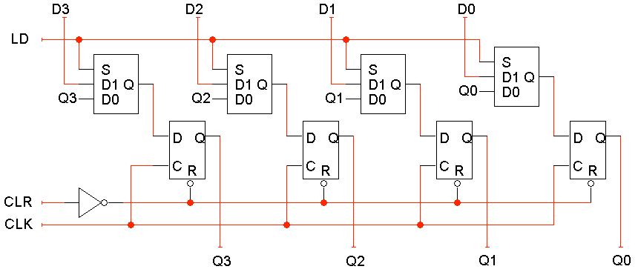
A better parallel load

Slide 18
A better parallel load
Another idea is to modify the flip-flop D inputs and not the clock signal.
  When LD = 0, the flip-flop inputs are Q3-Q0, so each flip-flop just keeps its current value.
  When LD = 1, the flip-flop inputs are D3-D0, and this new value is “loaded” into the register.

Slide 19
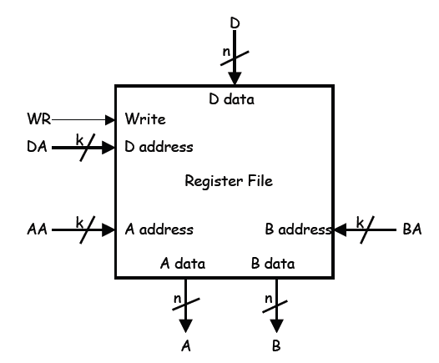
Register files

Slide 20
Register files
Modern processors contain a number of registers grouped together in a register file.
Much like words stored in a RAM, individual registers are identified by an address.
Here is a block symbol for a 2k x n register file.
  There are 2k registers, so register addresses are k bits long.
– Each register holds an n bit word, so the data inputs and outputs are n bits wide.

Slide 21
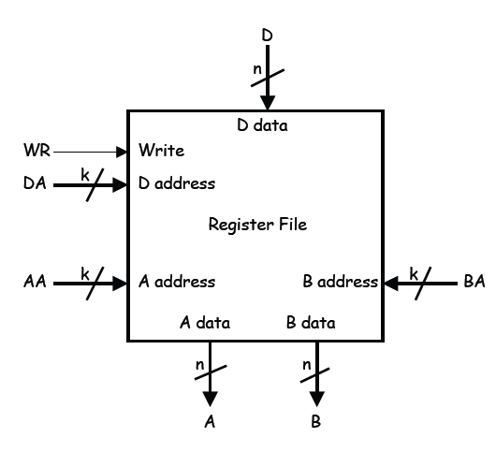
Accessing the register file

Slide 22
Accessing the register file
You can read two registers at once by supplying the AA and BA inputs.
The data appears on the A and B outputs.
You can write to a register by using the DA and D inputs, and setting WR = 1.
These are registers so there must be a clock signal, even though we usually don’t show it in diagrams.
  We can read from the register file at any time.
  Data is written only on the positive edge of the clock.

Slide 23
What’s inside the register file
Here’s a 4 x n register file. (We’ll assume a 4 x n register file for all our examples.)

Slide 24
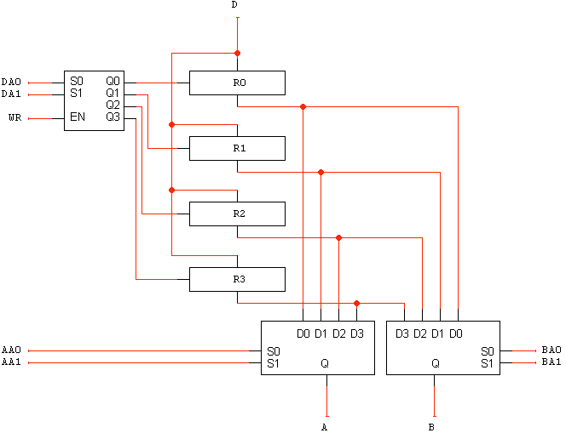
What’s inside the register file

Slide 25
What’s inside the register file
Here’s a 4 x n register file. (We’ll assume a 4 x n register file for all our examples.)

Slide 26
What’s inside the register file

Slide 27
What’s inside the register file

Slide 28
Explaining the register file
The 2-to-4 decoder selects one of the four registers for writing.
If WR = 1, the decoder will be enabled and one of the Load signals will be active.
The n-bit 4-to-1 muxes select the two register file outputs A and B, based on the inputs AA and BA.
We need to be able to read two registers at once because most arithmetic operations require two operands.

Slide 29
The all-important ALU
The main job of a central processing unit is to “process,” or to perform computations...

Slide 30
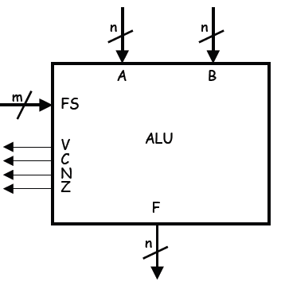
The all-important ALU

Slide 31
The all-important ALU
We’ll use the following general block symbol for the ALU.
  A and B are two n-bit numeric inputs.
  FS is an m-bit function select code, which picks one of 2m functions.
  The n-bit result is called F.
  Several status bits provide more information about the output F:
    V = 1 in case of signed overflow.
    C is the carry out.
    N = 1 if the result is negative.
    Z = 1 if the result is 0.

Slide 32
ALU functions
The table of operations is shown below
The function select code FS is 4 bits long, but there are only 15 different functions here.
We use an alternative notation for AND and OR to avoid confusion with arithmetic operations.

Slide 33
ALU functions
FS Operation
0000 F = A
0001 F = A + 1
0010 F = A + B
0011 F = A + B + 1
0100 F = A + B'
0101 F = A + B' + 1
0110 F = A - 1

Slide 34
ALU functions
FS Operation
0111 F = A
1000 F = A ! B (AND)
1001 F = A " B (OR)
1010 F = A # B (XOR)
1011 F = A'
1100 F = B
1101 F = sr B (shift r ight)
1110 F = sl B (shift left )

Slide 35
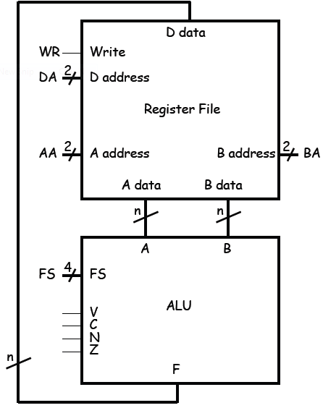
My first datapath

Slide 36
My first datapath
Here is the most basic datapath.
  The ALU’s two data inputs come from the register file.
  The ALU computes a result, which is saved back to the registers.
WR, DA, AA, BA and FS are control signals.

Slide 37
My first datapath
Their values determine the exact actions taken by the datapath— which registers are used and for what operation.
Remember that many of the signals here are actually multi-bit values.

Slide 38
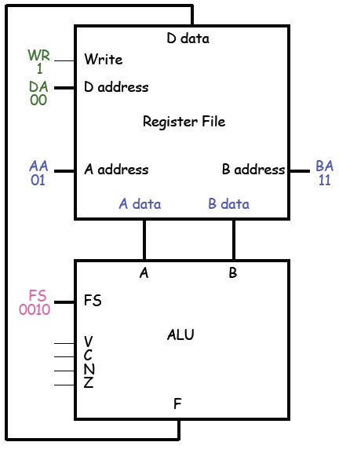
An example computation

Slide 39
An example computation
Let’s look at the proper control signals for the operation below:
R0 ← R1 + R3
• Set AA = 01 and BA = 11.
This causes the contents of R1 to appear at A data, and the contents of R3 to appear at B data.

Slide 40
An example computation
• Set the ALU’s function select input
FS = 0010 (A + B).
• Set DA = 00 and WR = 1. On the next
positive clock edge, the ALU result
(R1 + R3) will be stored in R0.

Slide 41
Two questions
Four registers isn’t a lot. What if we need more storage?
Who exactly decides which registers are read and written and which ALU function is executed?

Slide 42
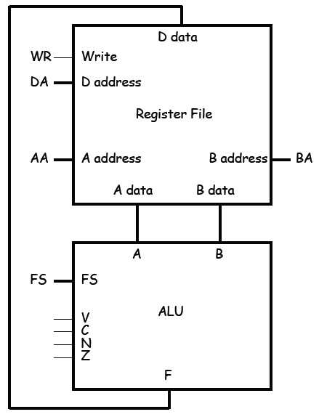
Two questions

Slide 43
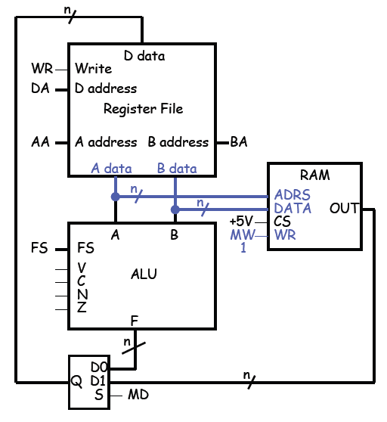
We can access RAM also

Slide 44
We can access RAM also
Here’s a way to connect RAM into our existing datapath.
To write to RAM, we must give an address and a data value.
These will come from the registers.
We connect A data to the memory’s ADRS input, and B data to the memory’s DATA input.

Slide 45
We can access RAM also
• Set MW = 1 to write to the RAM. (It’s called MW to distinguish it from the WR write signal on the register file.)

Slide 46
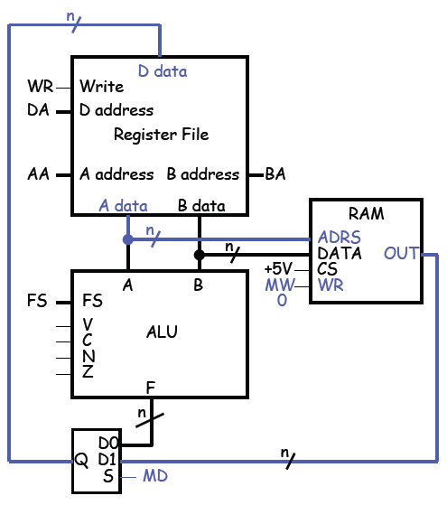
Reading from RAM

Slide 47
Reading from RAM
To read from RAM, A data must supply the address.
Set MW = 0 for reading.
The incoming data will be sent to the register file for storage.
This means that the register file’s D data input could come from either the ALU output or the RAM.

Slide 48
Reading from RAM
A mux MD selects the source for the register file.
  When MD = 0, the ALU output can be stored in the register file.
  When MD = 1, the RAM output is sent to the register file instead.

Slide 49
Notes about this setup
We now have a way to copy data between our register file and the RAM.
Notice that there’s no way for the ALU to directly access the memory—RAM contents must go through the register file first.

Slide 50
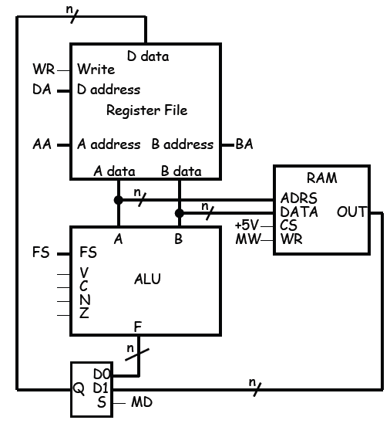
Notes about this setup

Slide 51
Notes about this setup
• Here the size of the memory is limited by the size of the registers; with n-bit registers, we can only use a 2n x n RAM.
For simplicity we’ll assume the RAM is at least as fast as the CPU clock. (This is definitely not the case in real processors these days.)

Slide 52
Memory transfer notation
In our transfer language, the contents at random access memory address X are denoted M[X]. For example:
  The first word in RAM is M[0].
  If register R1 contains an address, then M[R1] are the contents of that address.
The M[ ] notation is like a pointer dereference operation in C or C++.

Slide 53
Example sequence of operations
Here is a simple series of register transfer instructions:
R3 ← M[R0]
R3 ← R3 + 1
M[R0] ← R3

Slide 54
Example sequence of operations
This just increments the contents at address R0 in RAM.
  Again, our ALU only operates on registers, so the RAM contents must first be loaded into a register, and then saved back to RAM.
  R0 is the first register in our register file. We’ll assume it contains a valid memory address.
How would these instructions execute in our datapath?

Slide 55
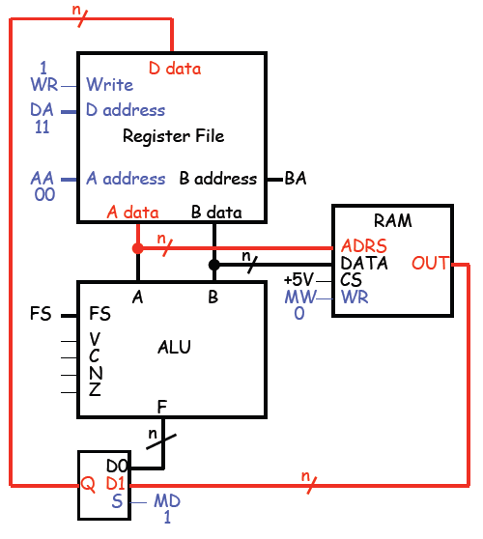
R3 ← M[R0]

Slide 56
R3 ← M[R0]
AA should be set to 00, to read register R0.
The value in R0 will be sent to the RAM address input, so M[R0] appears as the RAM output OUT.
MD must be 1, so the RAM output goes to the register file.
To store something into R3,

Slide 57
R3 ← M[R0]
we’ll need to set DA = 11 and WR = 1.
MW should be 0, so nothing is accidentally changed in RAM.
Here, we did not use the ALU (FS) or the second register file output (BA).

Slide 58
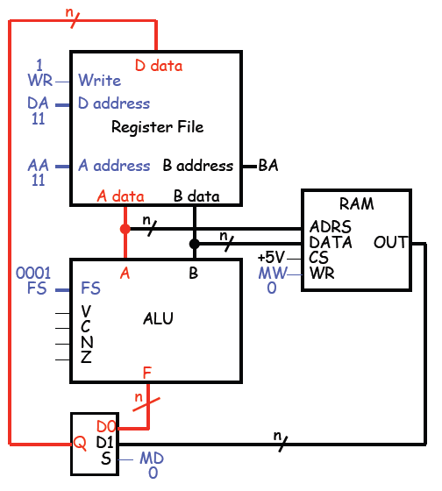
R3 ← R3 + 1

Slide 59
R3 ← R3 + 1
AA = 11, so R3 is read from the register file and sent to the ALU’s A input.
FS needs to be 0001 for the operation A + 1. Then, R3 + 1 appears as the ALU output F.
If MD is set to 0, this output will go back to the register file.

Slide 60
R3 ← R3 + 1
To write to R3, we need to make DA = 11 and WR = 1.
Again, MW should be 0 so the RAM isn’t inadvertently changed.
We didn’t use BA.

Slide 61
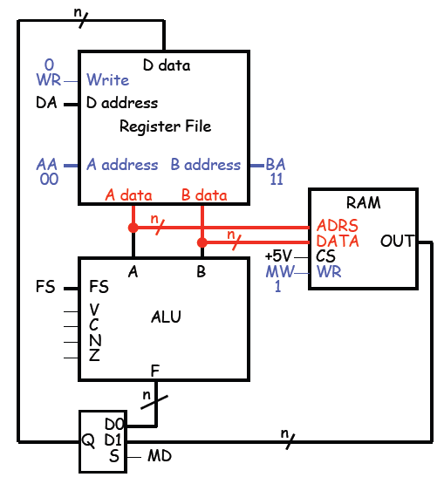
M[R0] ← R3

Slide 62
M[R0] ← R3
Finally, we want to store the contents of R3 into RAM address R0.
Remember the RAM address comes from “A data,” and the contents come from “B data.”
So we have to set AA = 00 and BA = 11. This sends R0 to ADRS, and R3 to DATA.

Slide 63
M[R0] ← R3
MW must be 1 to write to memory.
No register updates are needed, so WR should be 0, and MD and DA are unused.
We also didn’t use the ALU, so FS was ignored.

Slide 64
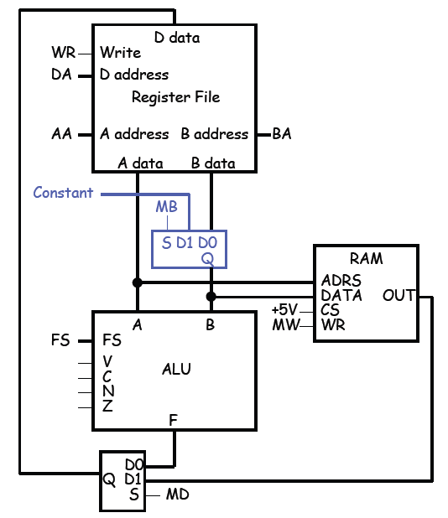
Constant in

Slide 65
Constant in
One last refinement is the addition of a Constant input.
The modified datapath is shown on the right, with one extra control signal MB.
We’ll see how this is used later. Intuitively, it provides an easy way to initialize a register or memory location with some arbitrary number.

Slide 66
Control units
From these examples, you can see that different actions are performed when we provide different inputs for the datapath control signals.

Slide 67
The datapath is the part of a processor where computation is done.
– The basic components are an ALU, a register file and some RAM.
– The ALU does all of the computations, while the register file and
RAM provide storage for the ALU’s operands and results.

Slide 68
Control units
• The second question we had was “Who exactly decides which registers are read and written and which ALU function is executed?”
  In real computers, the datapath actions are determined by the program that’s loaded and running.
  A control unit is responsible for generating the correct control signals for a datapath, based on the program code.

Slide 69
Control units
We’ll talk about programs and control units next week.

Slide 70
Summary
Various control signals in the datapath govern its behavior.
Next week, we’ll see how programmers can give commands to the processor, and how those commands are translated in control signals for the datapath.

